Slide 1
Chapter 5. The Memory System

Slide 2
Overview
Basic memory circuits
Organization of the main memory
Cache memory concept
Virtual memory mechanism
Secondary storage

Slide 3
Some Basic Concepts

Slide 4
Basic Concepts
The maximum size of the memory that can be used in any computer is determined by the addressing scheme.
16-bit addresses = 2¹⁶ = 64K memory locations
Most modern computers are byte addressable.
W
ord
address
Byte address
Byte address
0
0
1
2
3
0
3
2
1
0
4
4
5
6
7
4
7
6
5
4
•
•
•
•
•
•
2
k
-
4
2
k
-
4
2
k
-
3
2
k
-
2
2
k
-
1
2
k
-
4
2
k
-
1
2
k
-
2
2
k
-
3
2
k
-
4
(a) Big-endian assignment
(b) Little-endian assignment

Slide 5
Traditional Architecture
Processor
Memory
k
-bit
address bus
MAR
n
-bit
data bus
Up to 2
k
addressable
MDR
locations
Word length =
n
bits
Control lines
R
/
W
( , MFC, etc.)
Figure 5.1. Connection of the memory to the processor.

Slide 6
Basic Concepts
“Block transfer” – bulk data transfer
Memory access time
Memory cycle time
RAM – any location can be accessed for a Read or Write operation in some fixed amount of time that is independent of the location’s address.
Cache memory
Virtual memory, memory management unit

Slide 7
Semiconductor RAM Memories

Slide 8
Internal Organization of Memory Chips
b
7
b
′
7
b
1
b
′
1
b
0
b
′
0
W
0
•
•
•
FF
FF
A
0
W
1
•
•
•
A
1
Address
Memory
decoder
•
•
•
•
•
•
•
•
•
•
•
•
•
•
•
•
•
•
cells
A
2
A
3
W
15
•
•
•
16 words of 8 bits each: 16x8 memory org.. It has 16 external connections: addr. 4, data 8, control: 2, power/ground: 2
1K memory cells: 128x8 memory, external connections: ? 19(7+8+2+2)
1Kx1:? 15 (10+1+2+2)
Sense / Write
Sense / Write
Sense / Write
R
/
W
circuit
circuit
circuit
CS
Data input
/output lines:
b
7
b
1
b
0
Figure 5.2. Organization of bit cells in a memory chip.

Slide 9
A Memory Chip
5-bit row
address
W
0
W
1
5-bit
32
×
32
decoder
memory cell
array
W
31
Sense
/
Write
circuitry
10-bit
address
32-to-1
output multiplexer
R
/
W
and
CS
input demultiplexer
5-bit column
address
Data
input/output
Figure 5.3. Organization of a 1K × 1 memory chip.

Slide 10
Static Memories
The circuits are capable of retaining their state as long as power is applied.
b
b
′
T
1
X
Y
T
2
Word line
Bit lines
Figure 5.4. A static RAM cell.

Slide 11
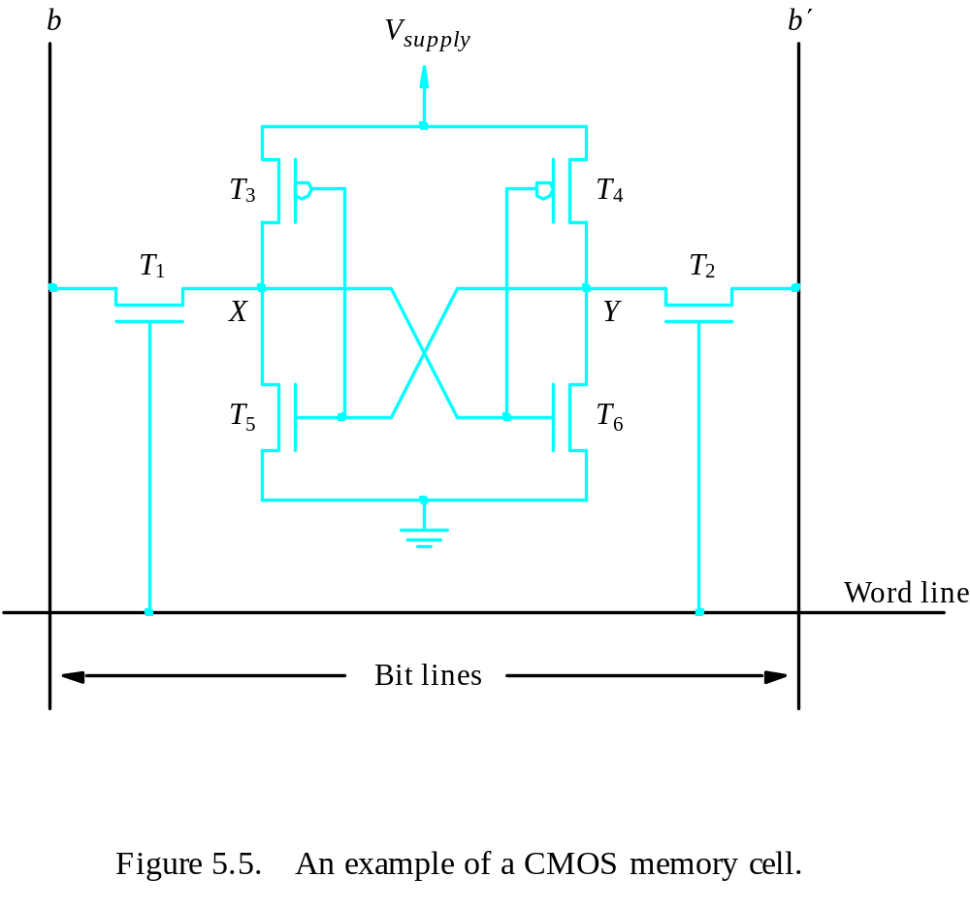
Static Memories
CMOS cell: low power consumption

Slide 12
Asynchronous DRAMs
Static RAMs are fast, but they cost more area and are more expensive.
Dynamic RAMs (DRAMs) are cheap and area efficient, but they can not retain their state indefinitely – need to be periodically refreshed.
Bit line
Word line
T
C
Figure 5.6. A single-transistor dynamic memory cell

Slide 13
A Dynamic Memory Chip
R
A
S
Row Addr. Strobe
Row
Row
4096
×
(
512
×
8
)
address
decoder
cell array
latch
A
20
-
9
⁄
A
8
-
0
Sense / Write
CS
circuits
R
/
W
Column
Column
address
decoder
latch
C
A
S
D
7
D
0
Column Addr. Strobe
Figure 5.7. Internal organization of a 2M × 8 dynamic memory chip.

Slide 14
Fast Page Mode
When the DRAM in last slide is accessed, the contents of all 4096 cells in the selected row are sensed, but only 8 bits are placed on the data lines D₇₋₀, as selected by A₈₋₀.
Fast page mode – make it possible to access the other bytes in the same row without having to reselect the row.
A latch is added at the output of the sense amplifier in each column.
Good for bulk transfer.

Slide 15
Synchronous DRAMs
The operations of SDRAM are controlled by a clock signal.
Refresh
counter
Row
Ro
w
address
decoder
Cell array
latch
Row/Column
address
Column
Co
lumn
Read/Write
address
decoder
circuits & latches
counter
Clock
R
A
S
Mode register
C
A
S
and
Data input
Data output
R
/
W
timing control
register
register
C
S
Figure 5.8. Synchronous DRAM.
Data

Slide 16
Synchronous DRAMs
Clock
R
/
W
R
A
S
C
A
S
Address
Row
Col
Data
D0
D1
D2
D3
Figure 5.9. Burst read of length 4 in an SDRAM.

Slide 17
Synchronous DRAMs
No CAS pulses is needed in burst operation.
Refresh circuits are included (every 64ms).
Clock frequency > 100 MHz
Intel PC100 and PC133

Slide 18
DDR SDRAM
Double-Data-Rate SDRAM
Standard SDRAM performs all actions on the rising edge of the clock signal.
DDR SDRAM accesses the cell array in the same way, but transfers the data on both edges of the clock.
The cell array is organized in two banks. Each can be accessed separately.
DDR SDRAMs and standard SDRAMs are most efficiently used in applications where block transfers are prevalent.

Slide 19
Latency and Bandwidth
Memory latency – the amount of time it takes to transfer a word of data to or from the memory.
Memory bandwidth – the number of bits or bytes that can be transferred in one second
Bandwidth =the rate at which data are transferred (and accessed) * the width of the data bus.

Slide 20
Structures of Larger Memories
21-bit
A
addresses
19-bit internal chip address
A
0
1
A
19
A
20
2-bit
decoder
512
K
×
8
memory chip
D
D
D
D
31-24
23-16
15-8
7-0
512
K
×
8
memory chip
19-bit
8-bit data
address
input/output
Chip select
Figure 5.10. Organization of a 2M × 32 memory module using 512K × 8 static memory chips.

Slide 21
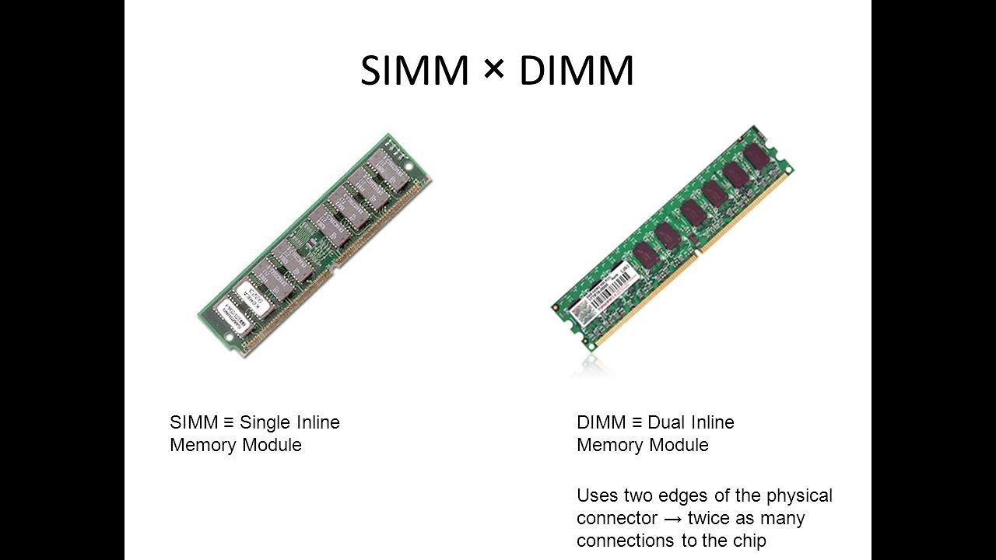

Slide 22
Memory System Considerations
The choice of a RAM chip for a given application depends on several factors:
Cost, speed, power, size…
SRAMs are faster, more expensive, smaller.
DRAMs are slower, cheaper, larger.
Which one for cache and main memory, respectively?
Refresh overhead – suppose a SDRAM whose cells are in 8K rows; 4 clock cycles are needed to access each row; then it takes 8192×4=32,768 cycles to refresh all rows; if the clock rate is 133 MHz, then it takes 32,768/(133×10⁻⁶)=246×10⁻⁶ seconds; suppose the typical refreshing period is 64 ms, then the refresh overhead is 0.246/64=0.0038<0.4% of the total time available for accessing the memory.

Slide 23
Memory Controller
Row/Column
Address
address
R
A
S
R
/
W
Memory
C
A
S
Request
controller
R
/
W
Processor
Memory
C
S
Clock
Clock
Data
Figure 5.11. Use of a memory controller.

Slide 24
Read-Only Memories

Slide 25
Read-Only-Memory
Bit line
Word line
T
Not connected to store a 1
P
Connected to store a 0
Figure 5.12. A ROM cell.

Slide 26
Volatile / non-volatile memory
ROM
PROM: programmable ROM
EPROM: erasable, reprogrammable ROM
EEPROM: can be programmed and erased electrically

Slide 27
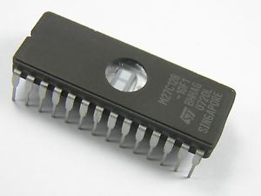
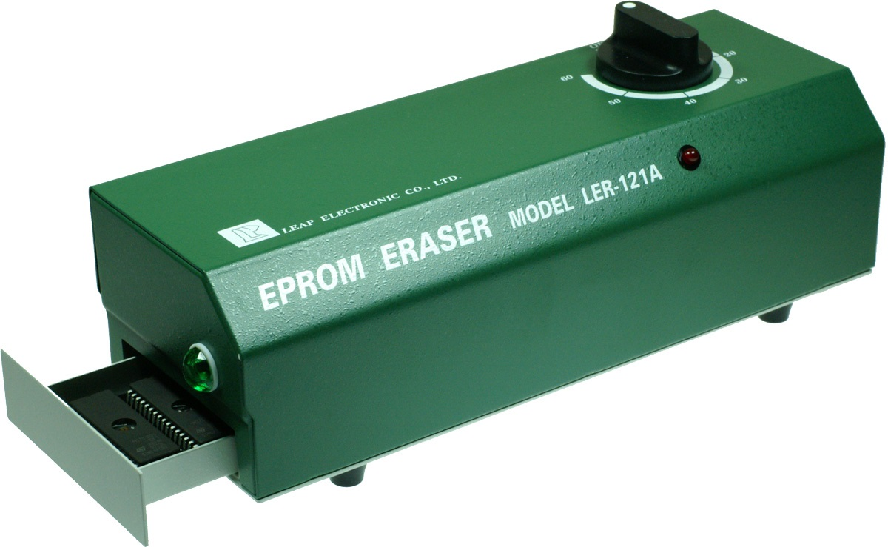

Slide 28
Flash Memory
Similar to EEPROM
Difference: only possible to write an entire block of cells instead of a single cell
Low power
Use in portable equipment
Implementation of such modules
  Flash cards
  Flash drives

Slide 29
Speed, Size, and Cost
Pr
ocessor
Re
gisters
Increasing
Increasing
Increasing
size
speed
cost per bit
Primary
L1
cache
Secondary
L2
cache
Main
memory
Magnetic disk
secondary
memory
Figure 5.13. Memory hierarchy.

Slide 30
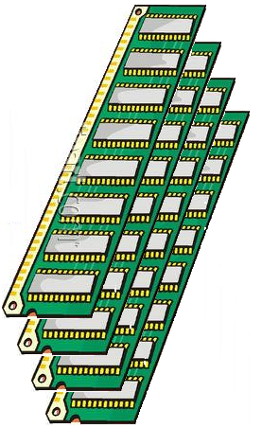
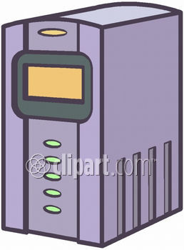
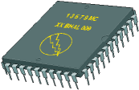
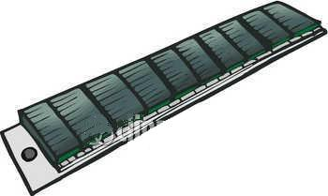


Memory Hierarchy
Main Memory
I/O Processor
CPU
Cache
Magnetic Disks
Magnetic Tapes
<number> / 19

Slide 31
Cache Memories

Slide 32
Cache
What is cache?
Why we need it?
Locality of reference
- temporal
- spatial
Cache block – cache line
  A set of contiguous address locations of some size

Slide 33
Cache
Main
Processor
Cache
memory
Figure 5.14. Use of a cache memory.
Replacement algorithm
Hit / miss
Write-through / Write-back
Load through

Slide 34
Cache Memory
High speed (towards CPU speed)
Small size (power & cost)
Main
Memory
(Slow)
τ_{Mem}
Miss
CPU
Cache
(Fast)
τ_{Cache}
Hit
95% hit ratio
τ_{Access} = 0.95 τ_{Cache} + 0.05 τ_{Mem}
<number> / 19

Slide 35
Cache Memory
Main
Memory
1 Gword
CPU
30-bit Address
Cache
1 Mword
Only 20 bits !!!
<number> / 19

Slide 36
Cache Memory
Main
Memory
00000000
00000001
•
•
•
•
•
•
•
•
•
•
3FFFFFFF
Cache
00000
00001
•
•
•
•
FFFFF
Address Mapping !!!
<number> / 19

Slide 37
Direct Mapping
Main
memory
Block 0
Block 1
Block j of main memory maps onto block j modulo 128 of the cache
Cache
Block 127
tag
Block 0
Block 128
tag
Block 1
Block 129
4: one of 16 words. (each block has 16=2⁴ words)
7: points to a particular block in the cache (128=2⁷)
5: 5 tag bits are compared with the tag bits associated with its location in the cache. Identify which of the 32 blocks that are resident in the cache (4096/128).
tag
Block 127
Block 255
Block 256
Block 257
Figure 5.15. Direct-mapped cache.
Block 4095
T
ag
Block
W
ord
5
7
4
Main memory address

Slide 38
Direct Mapping
Address
What happens when Address
= 100 00500
000 00500
00000
Cache
00500
000
0 1 A 6
Tag
Data
00900
080
4 7 C C
000
0 1 A 6
01400
150
0 0 0 5
FFFFF
Compare
Match
No match
20
Bits
(Addr)
10 Bits
(Tag)
16 Bits
(Data)
<number> / 19

Slide 39
Direct Mapping with Blocks
Address
000 0050 0
Block Size = 16
00000
Cache
00500
00501
•
000
0 1 A 6
0 2 5 4
Tag
Data
00900
00901
•
080
4 7 C C
A 0 B 4
000
0 1 A 6
01400
01401
•
150
0 0 0 5
5 C 0 4
FFFFF
Compare
Match
No match
20
Bits
(Addr)
10 Bits
(Tag)
16 Bits
(Data)
<number> / 19

Slide 40
Direct Mapping
T
ag
Block
W
ord
5
7
4
Main memory address
11101,1111111,1100
Tag: 11101
Block: 1111111=127, in the 127th block of the cache
Word:1100=12, the 12th word of the 127th block in the cache

Slide 41
Associative Mapping
Main
memory
Block 0
Block 1
Cache
tag
Block 0
tag
Block 1
Block
i
tag
Block 127
4: one of 16 words. (each block has 16=2⁴ words)
12: 12 tag bits Identify which of the 4096 blocks that are resident in the cache 4096=2¹².
Block 4095
T
ag
W
ord
12
4
Main memory address
Figure 5.16. Associative-mapped cache.

Slide 42
Associative Memory
Cache Location
Main
Memory
00000000
00000001
•
•
00012000
•
•
08000000
•
•
15000000
•
3FFFFFFF
Cache
00000
00001
•
•
•
•
FFFFF
00012000
15000000
08000000
Address (Key)
Data
<number> / 19

Slide 43
Associative Mapping
Address
00012000
Can have any number of locations
Cache
00012000
0 1 A 6
Data
15000000
0 0 0 5
0 1 A 6
08000000
4 7 C C
How many comparators?
30 Bits
(Key)
16 Bits
(Data)
<number> / 19

Slide 44
Associative Mapping
T
ag
W
ord
12
4
Main memory address
111011111111,1100
Tag: 111011111111
Word:1100=12, the 12th word of a block in the cache

Slide 45
Set-Associative Mapping
Main
memory
Block 0
Block 1
Cache
tag
Block 0
Set 0
Block 63
tag
Block 1
tag
Block 64
Set 1
Block 2
tag
Block 65
Block 3
4: one of 16 words. (each block has 16=2⁴ words)
6: points to a particular set in the cache (128/2=64=2⁶)
6: 6 tag bits is used to check if the desired block is present (4096/64=2⁶).
tag
Block 127
Set 63
Block 126
tag
Block 128
Block 127
Block 129
Block 4095
Figure 5.17. Set-associative-mapped cache with two blocks per set.
T
ag
Set
W
ord
6
6
4
Main memory address

Slide 46
Set-Associative Mapping
Address
000 00500
2-Way Set Associative
00000
Cache
00500
000
0 1 A 6
010
0 7 2 1
Tag1
Data1
Tag2
Data2
00900
080
4 7 C C
000
0 8 2 2
000
0 1 A 6
010
0 7 2 1
01400
150
0 0 0 5
000
0 9 0 9
FFFFF
Compare
Compare
20
Bits
(Addr)
10 Bits
(Tag)
16 Bits
(Data)
10 Bits
(Tag)
16 Bits
(Data)
Match
No match
<number> / 19

Slide 47
Set-Associative Mapping
T
ag
Set
W
ord
6
6
4
Main memory address
111011,111111,1100
Tag: 111011
Set: 111111=63, in the 63th set of the cache
Word:1100=12, the 12th word of the 63th set in the cache

Slide 48
Replacement Algorithms
Difficult to determine which blocks to kick out
Least Recently Used (LRU) block
The cache controller tracks references to all blocks as computation proceeds.
Increase / clear track counters when a hit/miss occurs

Slide 49
Replacement Algorithms
For Associative & Set-Associative Cache
  Which location should be emptied when the cache is full and a miss occurs?
  First In First Out (FIFO)
  Least Recently Used (LRU)
Distinguish an Empty location from a Full one
  Valid Bit
<number> / 19

Slide 50
Replacement Algorithms
CPU Reference
A
B
C
A
D
E
A
D
C
F
Miss
Miss
Miss
Hit
Miss
Miss
Miss
Hit
Hit
Miss
Cache
FIFO ➔
A
A
A
A
A
E
E
E
E
E
B
B
B
B
B
A
A
A
A
C
C
C
C
C
C
C
F
D
D
D
D
D
D
Hit Ratio = 3 / 10 = 0.3
<number> / 19

Slide 51
Replacement Algorithms
CPU Reference
A
B
C
A
D
E
A
D
C
F
Miss
Miss
Miss
Hit
Miss
Miss
Hit
Hit
Hit
Miss
Cache
LRU ➔
A
B
C
A
D
E
A
D
C
F
A
B
C
A
D
E
A
D
C
A
B
C
A
D
E
A
D
B
C
C
C
E
A
Hit Ratio = 4 / 10 = 0.4
<number> / 19

Slide 52
Performance Considerations

Slide 53
Overview
Two key factors: performance and cost
Price/performance ratio
Performance depends on how fast machine instructions can be brought into the processor for execution and how fast they can be executed.
For memory hierarchy, it is beneficial if transfers to and from the faster units can be done at a rate equal to that of the faster unit.
This is not possible if both the slow and the fast units are accessed in the same manner.
However, it can be achieved when parallelism is used in the organizations of the slower unit.

Slide 54
Interleaving
If the main memory is structured as a collection of physically separated modules, each with its own ABR (Address buffer register) and DBR( Data buffer register), memory access operations may proceed in more than one module at the same time.
m
bits
k
bits
k
bits
m
bits
Address in module
Module
MM address
Module
Address in module
MM address
ABR
DBR
ABR
DBR
ABR
DBR
ABR
DBR
ABR
DBR
ABR
DBR
Module
Module
Module
Module
Module
Module
0
i
2
k
-
1
0
i
n
-
1
(b) Consecutive words in consecutive modules
(a) Consecutive words in a module
Figure 5.25. Addressing multiple-module memory systems.

Slide 55
Hit Rate and Miss Penalty
The success rate in accessing information at various levels of the memory hierarchy – hit rate / miss rate.
Ideally, the entire memory hierarchy would appear to the processor as a single memory unit that has the access time of a cache on the processor chip and the size of a magnetic disk – depends on the hit rate (>>0.9).
A miss causes extra time needed to bring the desired information into the cache.
Example 5.2, page 332.

Slide 56
Hit Rate and Miss Penalty (cont.)
T_{ave}=hC+(1-h)M
  T_{ave:} average access time experienced by the processor
  h: hit rate
  M: miss penalty, the time to access information in the main memory
  C: the time to access information in the cache
Example:
  Assume that 30 percent of the instructions in a typical program perform a read/write operation, which means that there are 130 memory accesses for every 100 instructions executed.
  h=0.95 for instructions, h=0.9 for data
  C=10 clock cycles, M=17 clock cycles, interleaved memory
  Time without cache 130x10
  Time with cache 100(0.95x1+0.05x17)+30(0.9x1+0.1x17)
  The computer with the cache performs five times better
= 5.04

Slide 57
How to Improve Hit Rate?
Use larger cache – increased cost
Increase the block size while keeping the total cache size constant.
However, if the block size is too large, some items may not be referenced before the block is replaced – miss penalty increases.
Load-through approach

Slide 58
Caches on the Processor Chip
On chip vs. off chip
Two separate caches for instructions and data, respectively
Single cache for both
Which one has better hit rate? -- Single cache
What’s the advantage of separating caches? – parallelism, better performance
Level 1 and Level 2 caches
L1 cache – faster and smaller. Access more than one word simultaneously and let the processor use them one at a time.
L2 cache – slower and larger.
How about the average access time?
Average access time: t_{ave} = h₁C₁ + (1-h₁)h₂C₂ + (1-h₁)(1-h₂)M
where h is the hit rate, C is the time to access information in cache, M is the time to access information in main memory.

Slide 59
Other Enhancements
Write buffer – processor doesn’t need to wait for the memory write to be completed
Prefetching – prefetch the data into the cache before they are needed
Lockup-Free cache – processor is able to access the cache while a miss is being serviced.

Slide 60
Virtual Memories

Slide 61
Overview
Physical main memory is not as large as the address space spanned by an address issued by the processor.
2³² = 4 GB, 2⁶⁴ = …
When a program does not completely fit into the main memory, the parts of it not currently being executed are stored on secondary storage devices.
Techniques that automatically move program and data blocks into the physical main memory when they are required for execution are called virtual-memory techniques.
Virtual addresses will be translated into physical addresses.

Slide 62
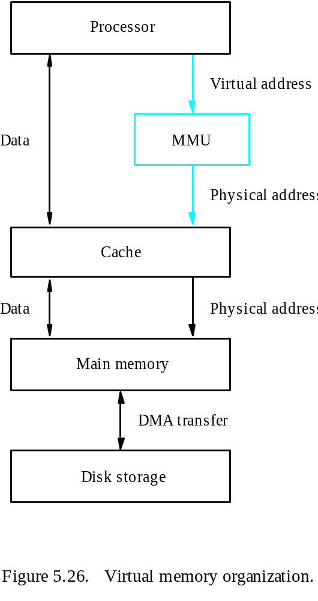
Overview
Memory Management Unit

Slide 63
Address Translation
All programs and data are composed of fixed-length units called pages, each of which consists of a block of words that occupy contiguous locations in the main memory.
Page cannot be too small or too large.
The virtual memory mechanism bridges the size and speed gaps between the main memory and secondary storage – similar to cache.

Slide 64
Example: Example of Address Translation
Code
Data
Heap
Stack
Data 2
Code
Data
Heap
Stack
Stack 1
Heap 1
Code 1
Stack 2
Prog 1
Virtual
Address
Space 1
Data 1
Prog 2
Virtual
Address
Space 2
Heap 2
Code 2
OS code
Translation Map 1
OS data
Translation Map 2
OS heap &
Stacks
Physical Address Space

Slide 65
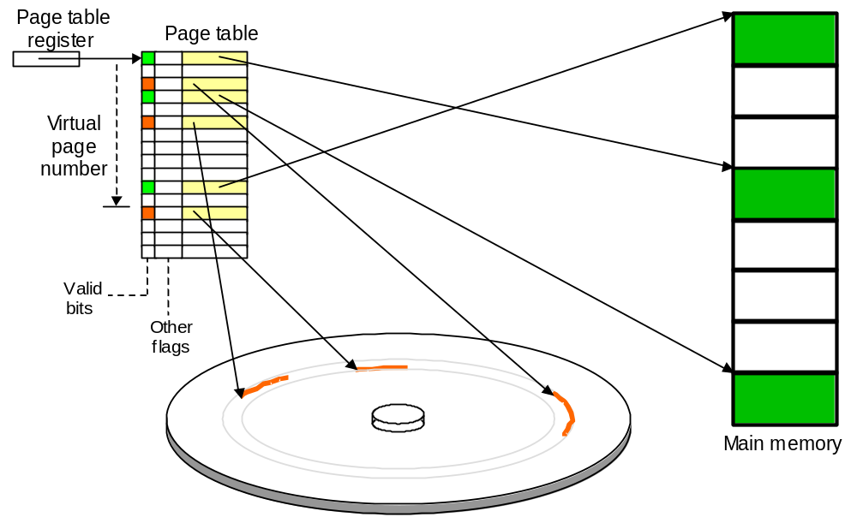
Page Tables and Address Translation
The role of page table in the virtual-to-physical address translation process.

Slide 66
Address Translation
Virtual address from processor
Page table base register
Page table address
Virtual page number
Offset
+
PAGE TABLE
Control
Page frame
bits
in memory
Page frame
Offset
Figure 5.27. Virtual-memory address translation.
Physical address in main memory

Slide 67
Address Translation
The page table information is used by the MMU for every access, so it is supposed to be with the MMU.
However, since MMU is on the processor chip and the page table is rather large, only small portion of it, which consists of the page table entries that correspond to the most recently accessed pages, can be accommodated within the MMU.
Translation Lookaside Buffer (TLB)

Slide 68
TLB
Virtual address from processor
Virtual page number
Offset
TLB
Virtual page
Control
Page frame
number
bits
in memory
No
=?
Yes
Miss
Hit
Page frame
Offset
Physical address in main memory
Figure 5.28. Use of an associative-mapped TLB.

Slide 69
TLB
The contents of TLB must be coherent with the contents of page tables in the memory.
Translation procedure.
Page fault
Page replacement
Write-through is not suitable for virtual memory.
Locality of reference in virtual memory

Slide 70
Memory Management Requirements
Multiple programs
System space / user space
Protection (supervisor / user state, privileged instructions)
Shared pages

Slide 71
Secondary Storage

Slide 72
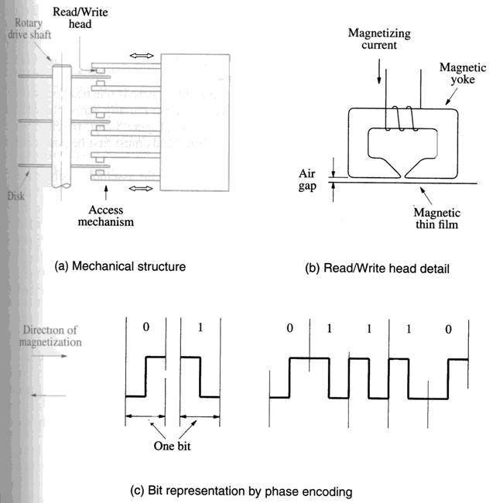
Magnetic Hard Disks
Disk
Disk drive
Disk controller

Slide 73
Organization of Data on a Disk
Sector 3, track
n
Sector 0, track 1
Sector 0, track 0
Figure 5.30. Organization of one surface of a disk.

Slide 74
Access Data on a Disk
Sector header
Following the data, there is an error-correction code (ECC).
Formatting process
Difference between inner tracks and outer tracks
Access time – seek time / rotational delay (latency time)
Data buffer/cache

Slide 75
Disk Controller
Processor
Main memory
System bus
Disk controller
Disk drive
Disk drive
Figure 5.31. Disks connected to the system bus.

Slide 76
Disk Controller
Seek
Read
Write
Error checking

Slide 77
RAID Disk Arrays
Redundant Array of Inexpensive Disks
Using multiple disks makes it cheaper for huge storage, and also possible to improve the reliability of the overall system.
RAID0 – data striping
RAID1 – identical copies of data on two disks
RAID2, 3, 4 – increased reliability
RAID5 – parity-based error-recovery

Slide 78
Optical Disks
Aluminum
Acrylic
Label
Pit
Land
Polycarbonate plastic
(a) Cross-section
Pit
Land
Reflection
Reflection
No reflection
Source
Detector
Source
Detector
Source
Detector
(b) Transition from pit to land
0
1
0
0
1
0
0
0
0
1
0
0
0
1
0
0
1
0
0
1
0
(c) Stored binary pattern
Figure 5.32. Optical disk.

Slide 79
Optical Disks
CD-ROM
CD-Recordable (CD-R)
CD-ReWritable (CD-RW)
DVD
DVD-RAM

Slide 80
Magnetic Tape Systems
File
File
mark
File
mark
•
•
•
•
•
•
•
•
7 or 9
bits
File gap
Record
Record
Record
Record
gap
gap
Figure 5.33. Organization of data on magnetic tape.

Slide 81
Homework
Page 361: 5.6, 5.9, 5.10(a)
Due time: 10:30am, Monday, March 26

Slide 82
Requirements for Homework
5.6. (a): 1 credits
5.6. (b):
  Draw a figure to show how program words are mapped on the cache blocks: 2
  Sequence of reads from the main memory blocks into cache blocks:2
  Total time for reading blocks from the main memory: 2
  Executing the program out of the cache:
    Beginning section of program:1
    Outer loop excluding Inner loop:1
    Inner loop:1
    End section of program:1
  Total execution time:1

Slide 83
Hints for Homework
Assume that consecutive addresses refer to consecutive words. The cycle time is for one word
Total time for reading blocks from the main memory: the number of readsx128x10
Executing the program out of the cache
  MEM word size for instructionsxloopNumx1
    Outer loop excluding Inner loop: (outer loop word size-inner loop word size)x10x1
    Inner loop: inner loop word sizex20x10x1
  MEM word size from MEM 23 to 1200 is 1200-22
  MEM word size from MEM 1201 to 1500(end) is 1500-1200

